Slide 1
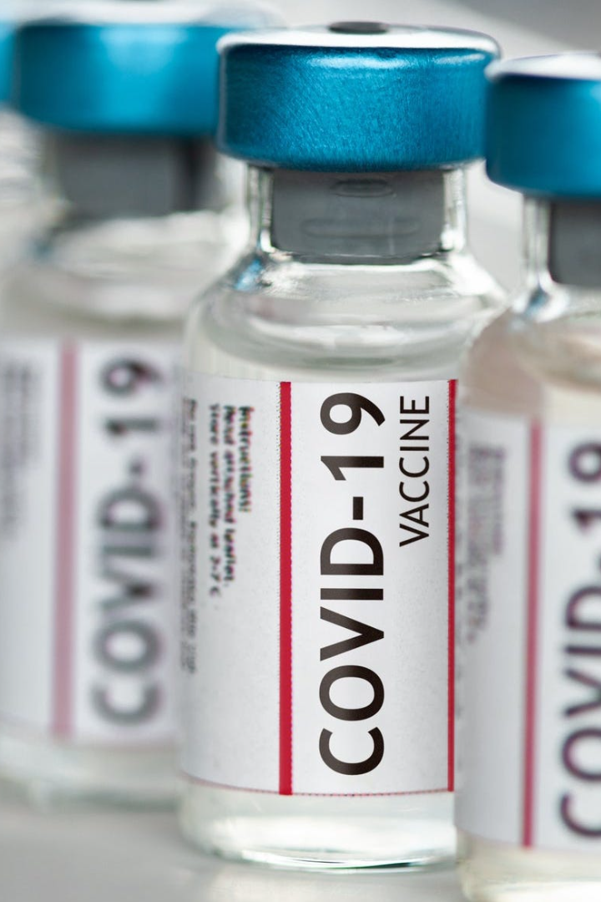

COVID-19 Vaccines: A Closer Look
Explore the development process, efficacy, safety, global distribution challenges, vaccine hesitancy, potential side effects, and the impact of vaccination on controlling the pandemic.
Done by,
Neharika.K
Shalu Priya.R
Sandhiya.B
Sree Lekha.S
Surthika Benzey.S

Slide 2
COVID-19 Vaccine Development Process
1
Research & Preclinical Studies
Extensive laboratory research and testing of potential vaccine candidates.
2
Clinical Trials
Phases 1, 2, and 3 trials to evaluate safety, efficacy, and dosing.
3
Regulatory Approval
Review of data by regulatory authorities followed by approval if proven safe and effective.

Slide 3
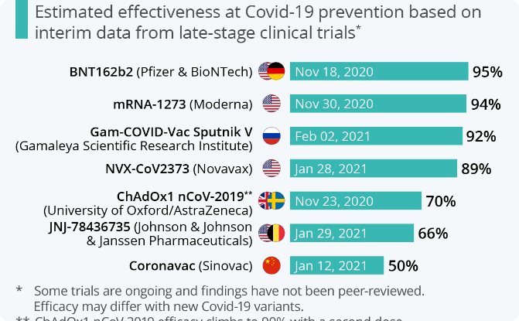
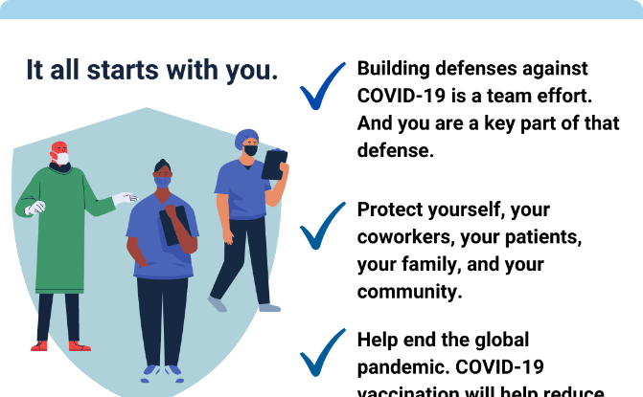
Efficacy and Safety of Approved Vaccines
Efficacy
Safety
Approved vaccines have shown high efficacy in preventing COVID-19 infections.
Clinical trials have demonstrated that approved vaccines have a favorable safety profile.

Slide 4
Global Distribution Challenges
Supply Constraints
Cold Chain Requirements
Inadequate vaccine production capacity leading to limited supply.
Transporting and storing vaccines at ultra-low temperatures in some cases.
Equitable Access
Logistics and Infrastructure
Ensuring fair and equitable distribution across countries and populations.
Establishing efficient systems for vaccine distribution in remote areas.

Slide 5

Vaccine Hesitancy and Misinformation
1
Impact of Misinformation
2
Educating the Public
3
Building Vaccine Confidence
Effective communication to address concerns and provide accurate information.
Misleading information can undermine public trust in vaccines.
Highlighting the benefits and safety of vaccines to combat hesitancy.

Slide 6
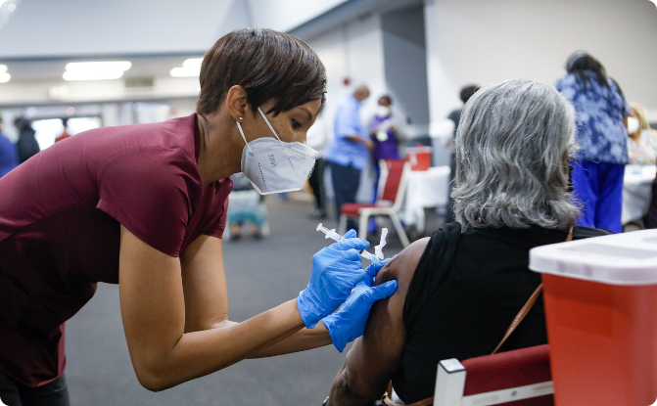
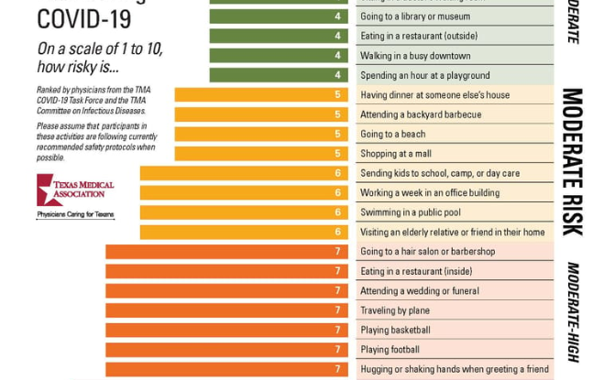
Potential Side Effects and Risk Assessment
Common Side Effects
Risk Assessment
Mild side effects such as soreness at the injection site and fatigue are temporary.
The overall benefits of vaccination outweigh the potential risks.

Slide 7
Impact of Vaccination on Controlling the Pandemic
1
Reducing Transmission
Vaccination plays a crucial role in breaking the chain of COVID-19 transmission.
Hospitalizations & Deaths
2
Vaccines significantly reduce severe illness and mortality rates.
3
Her immunity
Reaching herd immunity through vaccination can help return to normalcy.

Slide 8
Future Perspectives and Ongoing Research
Variants and Booster Shots
Long-Term Immunity
Global Collaboration
Studying the duration of protection provided by COVID-19 vaccines.
Ongoing efforts to ensure equitable access and support vaccination programs worldwide.
Research continues to evaluate vaccine effectiveness against emerging variants.

